Slide 1

MACHINE INTELLIGENCE
Srinivas K.S
Department of Computer Science
and Engineering

Slide 2

MACHINE INTELLIGENCE
Module 4 [Unsupervised Learning]
SRINIVAS K S
Department of Computer Science and Engineering

Slide 3

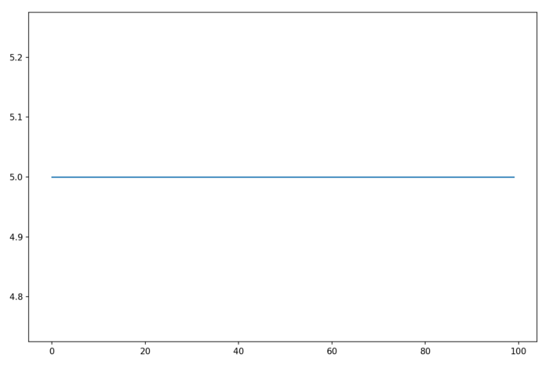
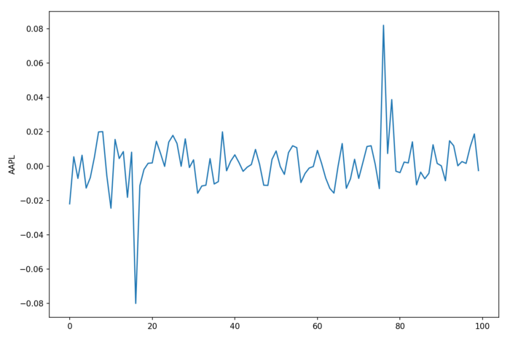
MACHINE INTELLIGENCE
Principal Component Analysis (PCA)
Variance is Both Our Enemy and Our Friend
Which of the data patterns do you find more interesting?
Data with no variance has no uncertainty, so there is nothing for us to predict or explain

Slide 4
MACHINE INTELLIGENCE
Need For Principal Component Analysis (PCA)
Variance is basically how much the data bounces up and down by. The more bouncy it is, the harder it is to predict or explain
But amidst all that noise, bouncy data also contains signal (a.k.a. information)
bouncy data is both infinitely more interesting as the target variable of your model and infinitely more useful as a feature variable inside your model

Slide 5
MACHINE INTELLIGENCE
Need For Principal Component Analysis (PCA)
Enemy: Target variable variance makes it harder to predict as the target variable creates uncertainty
Friend: To build a good model we need features with signals and when features have non-zero co-variances we have features with signals
Application: Working on molecular data to predict toxicity. We have over 1024 features and less than 700 samples. Such a model would absolutely overfit
We are living in an age of information overload

Slide 6
MACHINE INTELLIGENCE
Need For Principal Component Analysis (PCA)
Now if only there were an algorithm that could transform our 1024 features into an ideal set of feature
Ideal:
High Variance - Signals
Uncorrelated
Few Features - Overfit
Uncorrelated: Imagine a room full of stock traders all working hand in glove. If all of them are wrong the stock market would tank
Application: working on molecular data to predict toxicity. We have over 1024 features and less than 700 samples. Such a model would absolutely overfit
PCA (Principal Components Analysis) gives us our ideal set of features

Slide 7
MACHINE INTELLIGENCE
Need For Principal Component Analysis (PCA)
PCA creates a set of principal components
Rank ordered by variance (the first component has higher variance than the second, and so on)
Uncorrelated
Low in number (we can throw away the lower ranked components as they contain little signal).
Trying to make sense of a large number of feature variables for prediction is very hard
So we do dimensionality reduction – reducing feature space
Feature Extraction
Feature Elimination

Slide 8
MACHINE INTELLIGENCE
Need For Principal Component Analysis (PCA)
Feature Elimination: Drop ones that don’t contribute to the prediction. Prevents overfitting and easy to interpret but signals from features that you dropped are lost.
Feature Extraction:
Create new variables ( may be the same number of them ) which each of these new variables is a combination of the earlier variables
Each of these new variables also contain a signal on how well they predict the target variable
We order (rank ) the new variable in their order of how well they predict the target variable
Less Significant ones can be chopped off
Retained variables contain most valuable parts of the old variables – thus some amount of signal is retained

Slide 9
MACHINE INTELLIGENCE
Need For Principal Component Analysis (PCA)
Principal component analysis is a technique for feature extraction
It combines our input variables in a specific way, then we can drop the “least important” variables
Still retaining the most valuable parts of all of the variables!
The assumptions of the model gives us the additional benefit of linear independence
When should I use PCA?
Do you want to reduce the number of variables, but aren’t able to identify variables to completely remove from consideration?
Do you want to ensure your variables are independent of one another?
Are you comfortable making your independent variables less interpretable?

Slide 10
MACHINE INTELLIGENCE
Principal Component Analysis (PCA) – Intuitive understanding
At the very start of the process, PCA asks what is the strongest underlying trend in the feature set (we will call this component 1) – I will explain this in a bit
Next PCA asks what is the second strongest underlying trend in the feature set that also happens to be uncorrelated with component 1 (we will call it component 2)?
Then PCA asks what is the third strongest underlying trend in the feature set that also happens to be uncorrelated with both components 1 and 2 (we will call it component 3)?
And so on…

Slide 11
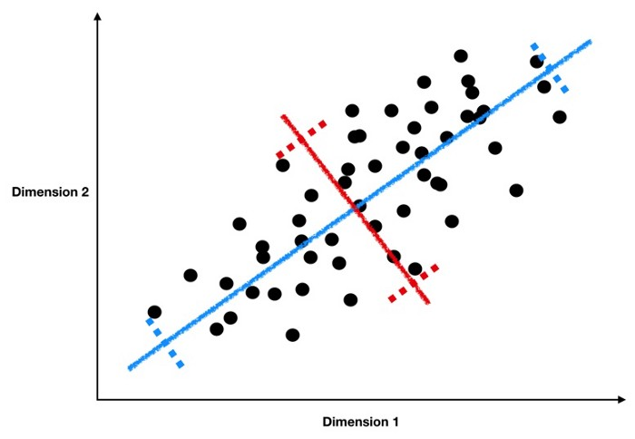
MACHINE INTELLIGENCE
Need For Principal Component Analysis (PCA)
In the above picture does the blue line indicate a better trend than the red line ?
If you looked at it as a linear regression problem you would say Yes!
The Blue line has more variance than the red line so given D1 it is easier to predict D2

Slide 12

MACHINE INTELLIGENCE
Need For Principal Component Analysis (PCA)
So our blue line is the Principal Component 1
The Principal component is a linear combination of the weighted combination of the features
The weighted sums that best express the underlying trends in our feature set – High Variance
Now for component 2, we want to find the second strongest underlying trend with the added condition that it is uncorrelated to component 1.
In statistics, trends and data that are orthogonal (a.k.a. perpendicular) to each other are uncorrelated.

Slide 13
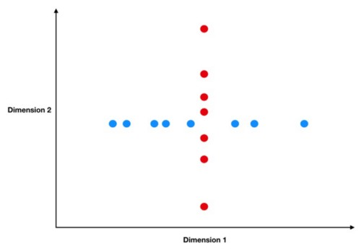
MACHINE INTELLIGENCE
Need For Principal Component Analysis (PCA)
In the plot on the right
All of the variation in the blue feature is horizontal and all the variation in the red one is vertical.
Thus, as the blue feature changes (horizontally), the red feature stays completely constant as it can only change vertically.

Slide 14
MACHINE INTELLIGENCE
Need for Eigen Vectors and the proofs
So far we have established that we would need to change the basis vectors and use basis vectors that have the highest degree of variance.
PCA a formal definition
Principal component analysis (PCA) is a statistical procedure that uses an orthogonal transformation to convert a set of observations of possibly correlated variables into a set of values of linearly uncorrelated variables called principal components.

Slide 15


MACHINE INTELLIGENCE
Need For Eigen Vectors
The resulting principal components are always orthogonal to each other and descending in variability
There are 2 different ways to derive the principal components:
Eigenvalue decomposition of the correlation matrix
Singular value decomposition of the data matrix, after a pre-processing step where we make sure the mean of the data set is zero
Suppose we have a feature vector
We need to find a vector c where
We need an encoding function

Slide 16




MACHINE INTELLIGENCE
Need For Principal Component Analysis (PCA)
We would also need a decoder function such that
Lets simplify this
The Size of matrix D is

Slide 17
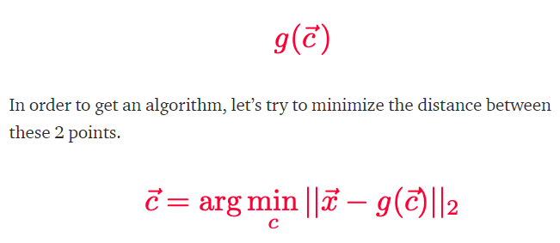
MACHINE INTELLIGENCE
Need For Principal Component Analysis (PCA)
The original version, x
The encoded and decoded version, x-ish, let’s call it:

Slide 18
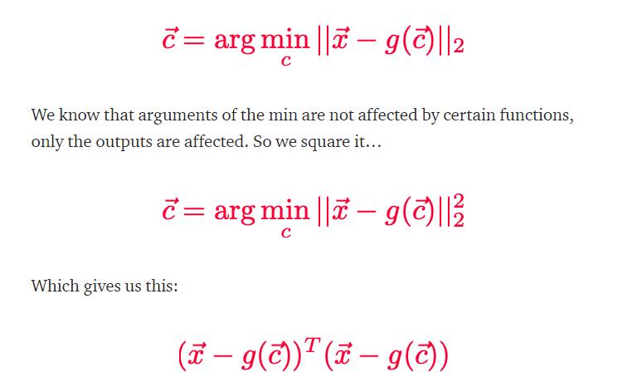
MACHINE INTELLIGENCE
Need For Principal Component Analysis (PCA)

Slide 19
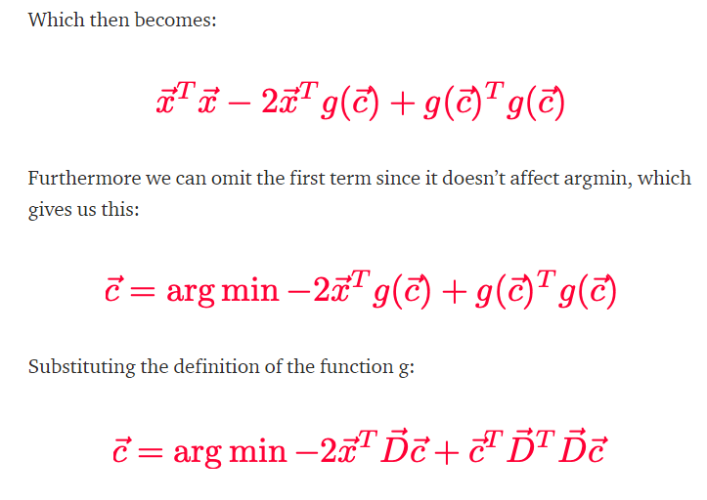
MACHINE INTELLIGENCE
Need For Principal Component Analysis (PCA)

Slide 20
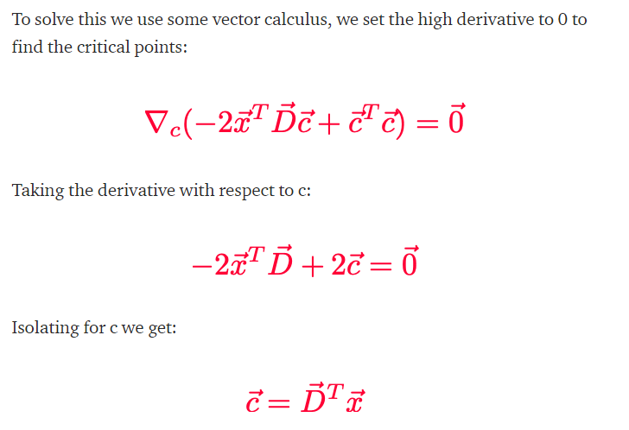
MACHINE INTELLIGENCE
Need For Principal Component Analysis (PCA)

Slide 21
MACHINE INTELLIGENCE
Need For Principal Component Analysis (PCA)

Slide 22
MACHINE INTELLIGENCE
Need For Principal Component Analysis (PCA)
Dimension Reduction
Process of converting a data set having vast dimensions into a data set with lesser dimensions.
Ensures that the converted data set conveys similar information concisely.

Slide 23
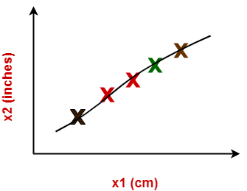

MACHINE INTELLIGENCE
Need For Principal Component Analysis (PCA)
Example
Consider the following graph shows dimensions x1 and x2
x1 represents the measurement of several objects in cm
x2 represents the measurement of several objects in inches
Using dimension reduction techniques-
We convert the dimensions of data from 2 dimensions (x1 and x2) to 1 dimension (z1).
It makes the data relatively easier to explain.

Slide 24
MACHINE INTELLIGENCE
Benefits of Dimensionality Reduction
Compresses the data and thus reduces the storage space requirements.
Reduces the time required for computation since less dimensions require less computation.
Eliminates the redundant features.
Improves the model performance.

Slide 25
MACHINE INTELLIGENCE
Dimensionality Reduction Technique : PCA
Well-known dimension reduction technique
Transforms the variables into a new set of variables called as principal components.
Principal components are linear combination of original variables and are orthogonal
The first principal component (PC1) accounts for most of the possible variation of original data
The second principal component (PC2) does its best to capture the variance in the data.

Slide 26
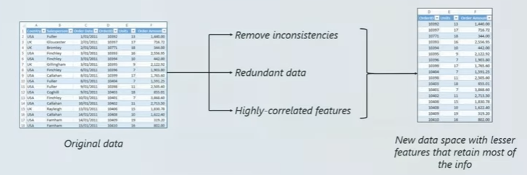
MACHINE INTELLIGENCE
Dimensionality Reduction Technique : PCA
Well-known dimension reduction technique
Transforms the variables into a new set of variables called as principal components.
The first principal component (PC1) accounts for most of the possible variation of original data
The second principal component (PC2) does its best to capture the variance in the data.
There can be only two principal components for a two-dimensional data set.

Slide 27
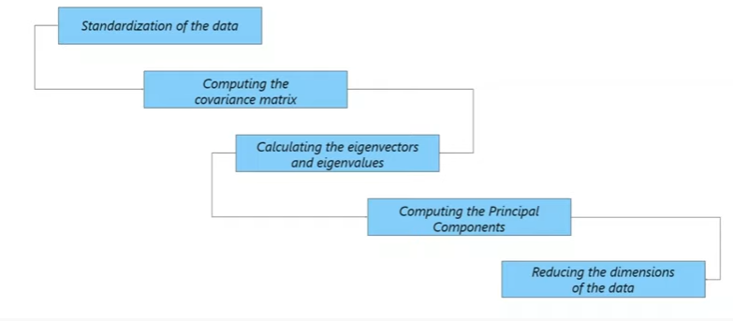
MACHINE INTELLIGENCE
PCA : STEPS

Slide 28

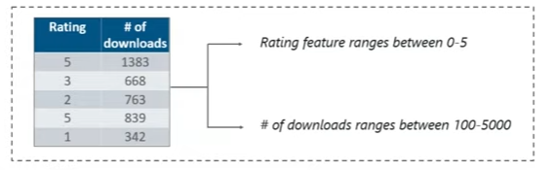
MACHINE INTELLIGENCE
PCA : STEPS
Step1: Standardization of Data
Scaling your data in such a way that all the variables and their values lie within a similar range.

Slide 29

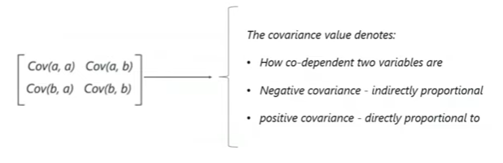
MACHINE INTELLIGENCE
PCA : STEPS
Step2: Computing Covariance Matrix
Expresses the correlation between the different variables in the data set.
Essential to identify heavily dependent variables because they contain biased and redundant information which reduces the overall performance of the model

Slide 30
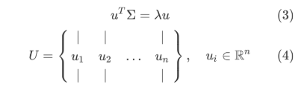
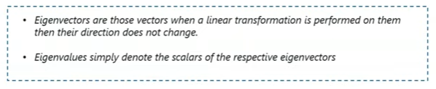
MACHINE INTELLIGENCE
PCA : STEPS
Step3: Calculating the EigenVectors and EigenValues
Eigenvectors and Eigenvalues are the mathematical constructs that must be computed from the covariance matrix in order to determine the principal components of the data set.
principal components are the new set of variables that are obtained from the initial set of variables. They compress and possess most of the useful information that was scattered among the initial variables

Slide 31
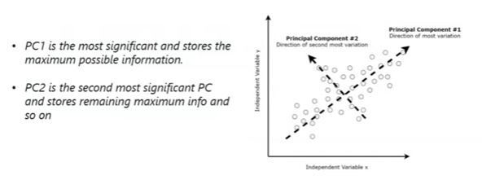
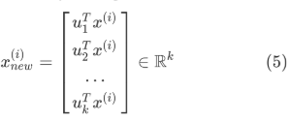
MACHINE INTELLIGENCE
PCA : STEPS
Step4:Compute Principal Components
Once we have computed the Eigenvectors and Eigenvalues, all we have to do is order them in the descending order, where the eigenvector with the highest eigenvalue is the most significant and thus forms the first principal component.

Slide 32
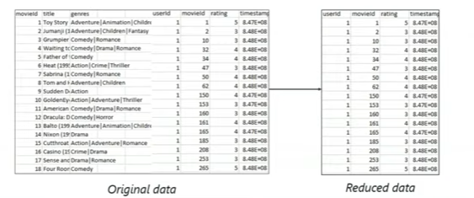
MACHINE INTELLIGENCE
PCA : STEPS
Step5: Reducing the dimensions of the Dataset
To re-arrange the original data with the final principal components which represent the maximum and the most significant information of the data set.

Slide 33
MACHINE INTELLIGENCE
PCA : STEPS
Step5: Reducing the dimensions of the Dataset
To re-arrange the original data with the final principal components which represent the maximum and the most significant information of the data set.

Slide 34
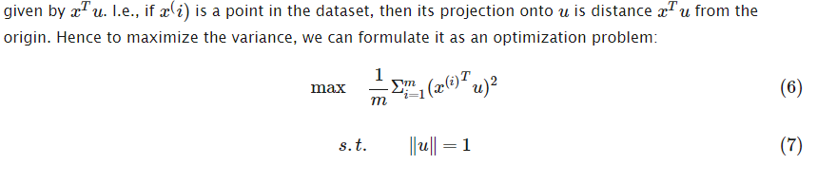
MACHINE INTELLIGENCE
PCA : Why do Eigen vectors have the highest co-variance
This is the projection of the raw data data

Slide 35
MACHINE INTELLIGENCE
PCA : Why do Eigen vectors have the highest co-variance
This is the projection of the raw data data

Slide 36
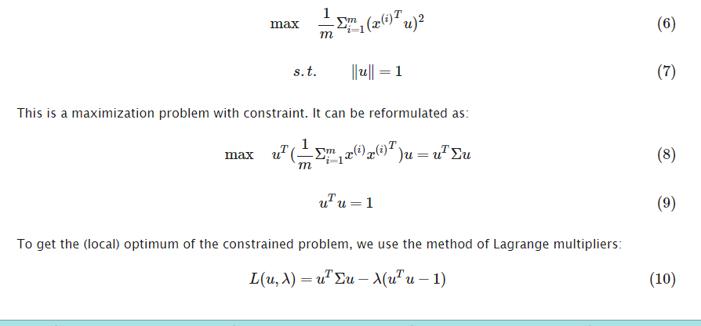
MACHINE INTELLIGENCE
PCA : Why do Eigen vectors have the highest co-variance

Slide 37
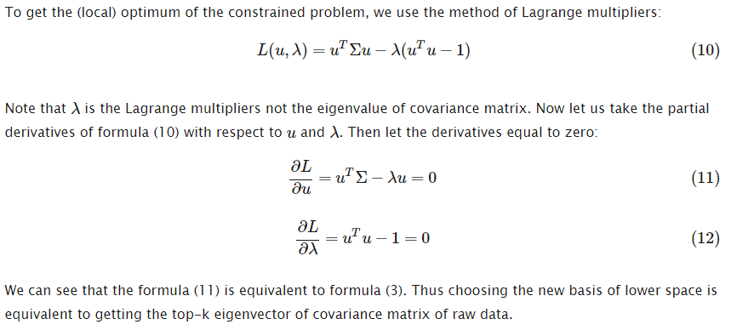
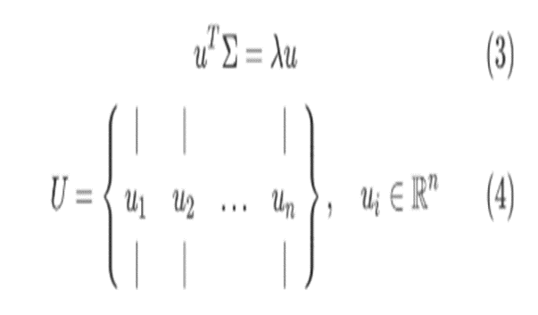
MACHINE INTELLIGENCE
PCA : Why do Eigen vectors have the highest co-variance
Thus choosing the new basis of lower space is equivalent to getting the top-k eigenvector of covariance matrix of raw data.

Slide 38
MACHINE INTELLIGENCE
PCA : STEPS
Step-01a: Get data.
Step-01b: Compute the mean vector (µ).
Step-01c: Subtract mean from the given data.
Step-02: Calculate the covariance matrix.
Step-03: Calculate the eigen vectors and eigen values of the covariance matrix.
Step-04: Choosing components and forming a feature vector.
Step-05: Deriving the new data set.

Slide 39
MACHINE INTELLIGENCE
PCA : Example
Consider the two dimensional patterns (2, 1), (3, 5), (4, 3), (5, 6), (6, 7), (7, 8).
Compute the principal component using PCA Algorithm.

Slide 40

MACHINE INTELLIGENCE
PCA : Example
Step 01a: Consider the two dimensional patterns (2, 1), (3, 5), (4, 3), (5, 6), (6, 7), (7, 8).

Slide 41

MACHINE INTELLIGENCE
PCA : Example
Step 01b: Calculate the mean vector (µ)
Mean vector (µ)
= ((2 + 3 + 4 + 5 + 6 + 7) / 6, (1 + 5 + 3 + 6 + 7 + 8) / 6)
= (4.5, 5)

Slide 42

MACHINE INTELLIGENCE
PCA : Example
Step 01c: Subtract mean vector (µ) from the given feature vectors
x₁ – µ = (2 – 4.5, 1 – 5) = (-2.5, -4)
x₂ – µ = (3 – 4.5, 5 – 5) = (-1.5, 0)
x₃ – µ = (4 – 4.5, 3 – 5) = (-0.5, -2)
x₄ – µ = (5 – 4.5, 6 – 5) = (0.5, 1)
x₅ – µ = (6 – 4.5, 7 – 5) = (1.5, 2)
x₆ – µ = (7 – 4.5, 8 – 5) = (2.5, 3)
Feature vectors (x_{i}) after subtracting mean vector (µ)

Slide 43
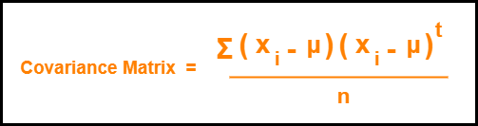
MACHINE INTELLIGENCE
PCA : Example
Step 02: Calculate the covariance matrix

Slide 44
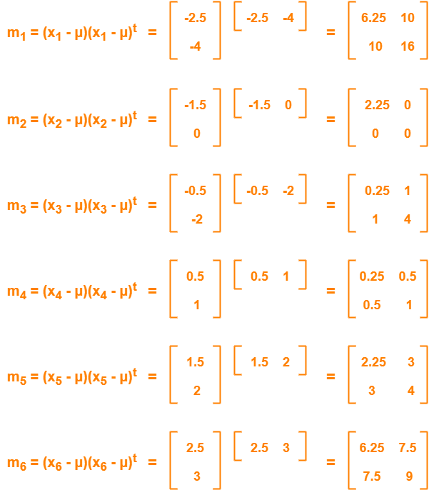
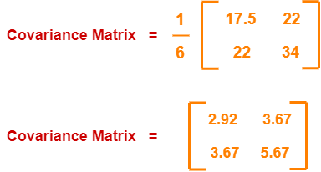
MACHINE INTELLIGENCE
PCA : Example
Step 02: Calculate the covariance matrix
Covariance matrix
= (m₁ + m₂ + m₃ + m₄ + m₅ + m₆) / 6
On adding the above matrices and dividing by 6, we get-

Slide 45
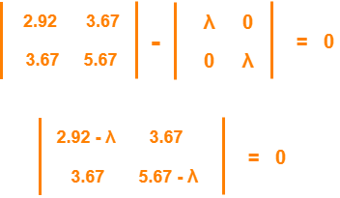
MACHINE INTELLIGENCE
PCA : Example
Step 03: Calculate the eigen values and eigen vectors of the covariance matrix
From here,
(2.92 – λ)(5.67 – λ) – (3.67 x 3.67) = 0
16.56 – 2.92λ – 5.67λ + λ² – 13.47 = 0
λ² – 8.59λ + 3.09 = 0
Solving this quadratic equation,
we get λ = 8.22, 0.38
Thus, two eigen values are
λ₁ = 8.22 and λ₂ = 0.38.

Slide 46

MACHINE INTELLIGENCE
PCA : Example
Step 03: Calculate the eigen values and eigen vectors of the covariance matrix
Eigen vector corresponding to the greatest eigen value is the principal component (PC1) for the given data set.
So, we find the eigen vector corresponding to eigen value λ₁.
We use the following equation to find the eigen vector-
MX = λX
where
M = Covariance Matrix
X = Eigen vector
λ = Eigen value
Substituting the values in the above equation, we get-

Slide 47

MACHINE INTELLIGENCE
PCA : Example
Step 03: Calculate the eigen values and eigen vectors of the covariance matrix
Solving these, we get-
2.92X₁ + 3.67X₂ = 8.22X₁
3.67X₁ + 5.67X₂ = 8.22X₂
On simplification, we get-
5.3X₁ = 3.67X₂ ………(1)
3.67X₁ = 2.55X₂ ………(2)
From (1) and (2), X₁ = 0.69X₂
From (2), the eigen vector is-

Slide 48

MACHINE INTELLIGENCE
PCA : Example
Step 03: Calculate the eigen values and eigen vectors of the covariance matrix

Slide 49
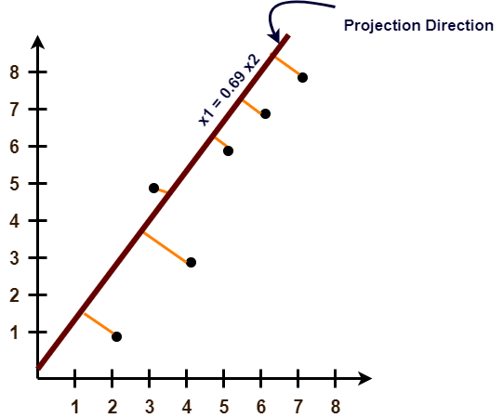
MACHINE INTELLIGENCE
PCA : Example
Step 04: Projecting the data points onto the new subspace

Slide 50

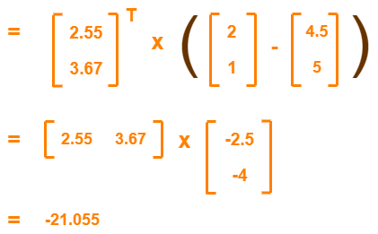
MACHINE INTELLIGENCE
PCA : Example2
Use PCA Algorithm to transform the pattern (2, 1) onto the eigen vector in the previous Example.
The feature vector gets transformed to
= Transpose of Eigen vector x (Feature Vector – Mean Vector)

Slide 51
MACHINE INTELLIGENCE
Summary

Slide 52
MACHINE INTELLIGENCE
Resources
http://www2.ift.ulaval.ca/~chaib/IFT-4102-7025/public_html/Fichiers/Machine_Learning_in_Action.pdf
http://wwwusers.cs.umn.edu/~kumar/dmbook/.
ftp://ftp.aw.com/cseng/authors/tan
http://web.ccsu.edu/datamining/resources.html

Slide 53
THANK YOU
Srinivas KS
Department of Computer Science and Engineering
srinivasks@pes.edu

Slide 54
MACHINE INTELLIGENCE
Dr. N MEHALA
Department of Computer Science and Engineering

Slide 55
MACHINE INTELLIGENCE
Module 4 [Unsupervised Learning]
Dr. N MEHALA
Department of Computer Science and Engineering

Slide 56
MACHINE INTELLIGENCE
Singular Value Decomposition : SVD

Slide 57
MACHINE INTELLIGENCE
Geometric Analysis of Linear Transformations
We want to know what a linear transformation A does
Need some simple and “comprehendible” representation of the matrix of A.
Let’s look what A does to some vectors
Since A(αv) = αA(v), it’s enough to look at vectors v of unit length
A

Slide 58
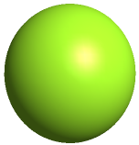
MACHINE INTELLIGENCE
The Geometry of Linear Transformations
A linear (non-singular) transform A always takes hyper-spheres to hyper-ellipses.
A
A

Slide 59
MACHINE INTELLIGENCE
The Geometry of Linear Transformations
Thus, one good way to understand what A does is to find which vectors are mapped to the “main axes” of the ellipsoid.
A
A

Slide 60
MACHINE INTELLIGENCE
Geometric Analysis of Linear Transformations
If we are lucky: A = V Λ V^{T}, V orthogonal (true if A is symmetric)
The eigenvectors of A are the axes of the ellipse
A

Slide 61
MACHINE INTELLIGENCE
Symmetric Matrix: Eigen Decomposition
In this case A is just a scaling matrix. The eigen decomposition of A tells us which orthogonal axes it scales, and by how much:
1
1
λ₁
A
λ₂

Slide 62
MACHINE INTELLIGENCE
General Linear Transformations: SVD
In general A will also contain rotations, not just scales:
1
1
σ₂
σ₁
A

Slide 63
MACHINE INTELLIGENCE
General Linear Transformations: SVD
1
1
σ₂
σ₁
A
orthonormal
orthonormal

Slide 64
MACHINE INTELLIGENCE
SVD More Formally
SVD exists for any matrix
Formal definition:
For square matrices A ∈ R^{n×n}, there exist orthogonal matrices U, V ∈ R^{n×n} and a diagonal matrix Σ, such that all the diagonal values σ_{i} of Σ are non-negative and
=

Slide 65
MACHINE INTELLIGENCE
SVD More Formally
The diagonal values of Σ (σ₁, …, σ_{n}) are called the singular values. It is accustomed to sort them: σ₁ ≥ σ₂≥ … ≥ σ_{n}
The columns of U (u₁, …, u_{n}) are called the left singular vectors. They are the axes of the ellipsoid.
The columns of V (v₁, …, v_{n}) are called the right singular vectors. They are the pre-images of the axes of the ellipsoid.
=

Slide 66
MACHINE INTELLIGENCE
Singular Values and Eigen Values Relation
For an m× n matrix A of rank r there exists a factorization
(Singular Value Decomposition = SVD) as follows:
m×m
m×n
V is n×n
The columns of U are orthogonal eigenvectors of AA^{T}.
The columns of V are orthogonal eigenvectors of A^{T}A.
Eigenvalues λ₁ … λ_{r} of AA^{T} are the eigenvalues of A^{T}A.
Singular values.

Slide 67

MACHINE INTELLIGENCE
SVD: Definition
A : Input Data Matrix
m X n matrix (eg. m documents, n terms)
U: Left singular Vectors
m X r matrix (eg. m documents, r concepts)
∑: Singular Values
r X r diagonal matrix (strength of each ‘concept’)
(r: rank of the matrix A)
V: Right Singular Vectors
n X r matrix (n terms and r concepts)

Slide 68
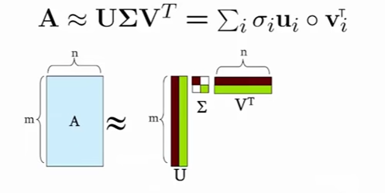
MACHINE INTELLIGENCE
SVD: Definition

Slide 69
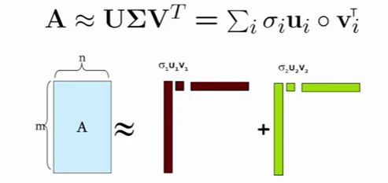
MACHINE INTELLIGENCE
SVD: Definition
σ_{i} … Scalar
u_{i} … Vector
v_{i} … Vector

Slide 70
MACHINE INTELLIGENCE
SVD Properties
It is always possible to decompose a real matrix A into
A = U ∑ V^{T} , where
U, ∑, V : unique
U, V : column orthonormal
U^{T} U = I ;V^{T} V = I (I: Identity matrix)
(Columns are orthogonal unit vectors)
∑ :diagonal
Entries (singular values) are positive, and sorted in decreasing order (σ₁≥σ₂≥.. ≥0)

Slide 71
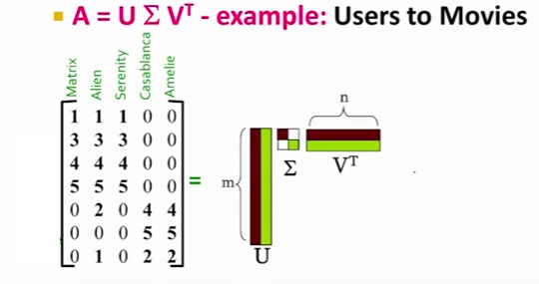
MACHINE INTELLIGENCE
SVD: Example (USERS TO MOVIES)

Slide 72
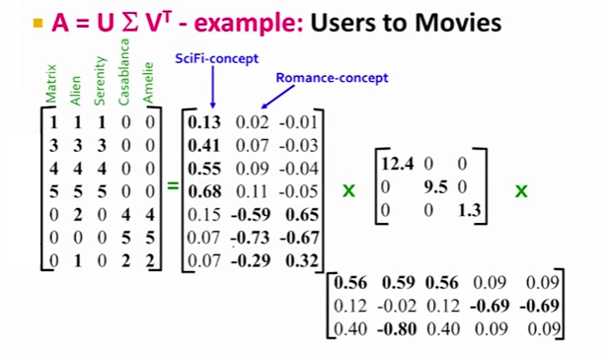

MACHINE INTELLIGENCE
SVD: Example (USERS TO MOVIES)

Slide 73

MACHINE INTELLIGENCE
SVD: Example (USERS TO MOVIES)

Slide 74
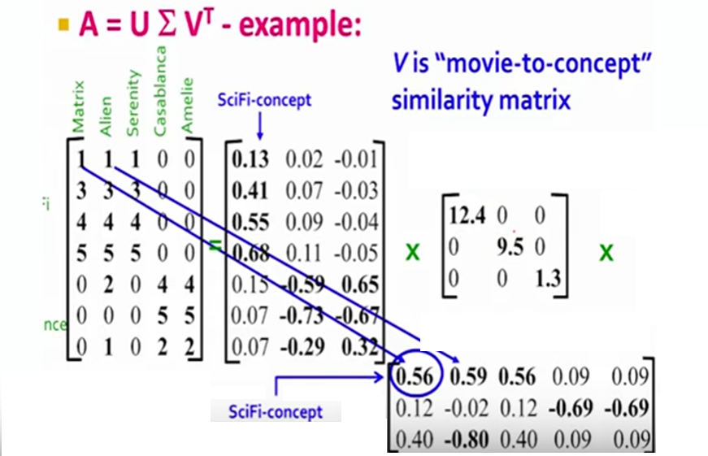
MACHINE INTELLIGENCE
SVD: Example (USERS TO MOVIES)

Slide 75
MACHINE INTELLIGENCE
SVD: Example (USERS TO MOVIES)
‘movies’, ‘users’, and ‘concepts’:
U: user-to-concept similarity matrix
V: movie-to-concept similarity matrix
∑: its diagonal elements: ‘strength’ of each concept

Slide 76
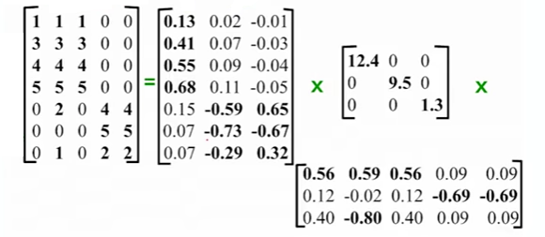
MACHINE INTELLIGENCE
SVD: Example (USERS TO MOVIES)
How exactly is Dimension reduction done?

Slide 77
MACHINE INTELLIGENCE
SVD: Example (USERS TO MOVIES)
How exactly is Dimension reduction done?
-Set smallest singular values to zero

Slide 78
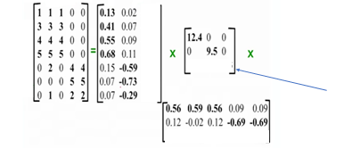
MACHINE INTELLIGENCE
SVD: Example (USERS TO MOVIES)
How exactly is Dimension reduction done?
-Set smallest singular values to zero

Slide 79
MACHINE INTELLIGENCE
Summary

Slide 80
MACHINE INTELLIGENCE
Resources
http://www2.ift.ulaval.ca/~chaib/IFT-4102-7025/public_html/Fichiers/Machine_Learning_in_Action.pdf
http://wwwusers.cs.umn.edu/~kumar/dmbook/.
ftp://ftp.aw.com/cseng/authors/tan
http://web.ccsu.edu/datamining/resources.html

Slide 81
THANK YOU
Dr. N MEHALA
Department of Computer Science and Engineering
mehala@pes.edu

Slide 82
MACHINE INTELLIGENCE
Dr. N MEHALA
Department of Computer Science and Engineering

Slide 83
MACHINE INTELLIGENCE
Module 4 [Unsupervised Learning]
Dr. N MEHALA
Department of Computer Science and Engineering

Slide 84
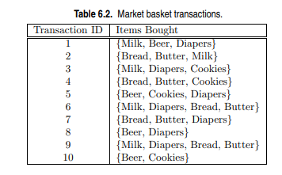
Practice Question 1
(d) Find an itemset (of size 2 or larger) that has the largest support.
(e) Find a pair of items, a and b, such that the rules {a} −→ {b} and {b} −→ {a} have the same confidence
(a) What is the maximum number of association rules that can be extracted from this data (including rules that have zero support)?
(b) What is the maximum size of frequent itemsets that can be extracted (assuming minsup > 0)?
(c) Write an expression for the maximum number of size-3 itemsets that can be derived from this data set.

Slide 85
Practice Question 2
Consider the following set of frequent 3-itemsets: {1, 2, 3}, {1, 2, 4}, {1, 2, 5}, {1, 3, 4}, {1, 3, 5}, {2, 3, 4}, {2, 3, 5}, {3, 4, 5}. Assume that there are only five items in the data set.
(a) List all candidate 4-itemsets obtained by a candidate generation procedure using the Fk−1 × F1 merging strategy.
(b) List all candidate 4-itemsets obtained by the candidate generation procedure in Apriori.
(c) List all candidate 4-itemsets that survive the candidate pruning step of the Apriori algorithm.

Slide 86
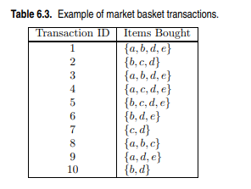
Practice Question 3
Draw an itemset lattice representing the data set given in Table 6.3. Label each node in the lattice with the following letter(s):
• N: If the itemset is not considered to be a candidate itemset by the Apriori algorithm. There are two reasons for an itemset not to be considered as a candidate itemset: (1) it is not generated at all during the candidate generation step, or (2) it is generated during the candidate generation step but is subsequently removed during the candidate pruning step because one of its subsets is found to be infrequent.
• F: If the candidate itemset is found to be frequent by the Apriori algorithm.
• I: If the candidate itemset is found to be infrequent after support counting.
(b) What is the percentage of frequent itemsets (with respect to all itemsets in the lattice)?
(c) What is the pruning ratio of the Apriori algorithm on this data set? (Pruning ratio is defined as the percentage of itemsets not considered to be a candidate because (1) they are not generated during candidate generation or (2) they are pruned during the candidate pruning step.)

Slide 87
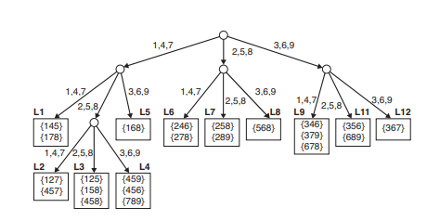
Practice Question 4
The Apriori algorithm uses a hash tree data structure to efficiently count the support of candidate itemsets. Consider the hash tree for candidate 3- itemsets shown in figure below:
Given a transaction that contains items {1, 3, 4, 5, 8}, which of the hash tree leaf nodes will be visited when finding the candidates of the transaction?
(b) Use the visited leaf nodes in part (b) to determine the candidate itemsets that are contained in the transaction {1, 3, 4, 5, 8}.

Slide 88
Practice Question 5
Consider the following set of candidate 3-itemsets: {1, 2, 3}, {1, 2, 6}, {1, 3, 4}, {2, 3, 4}, {2, 4, 5}, {3, 4, 6}, {4, 5, 6}
Construct a hash tree for the above candidate 3-itemsets. Assume the tree uses a hash function where all odd-numbered items are hashed to the left child of a node, while the even-numbered items are hashed to the right child. A candidate k-itemset is inserted into the tree by hashing on each successive item in the candidate and then following the appropriate branch of the tree according to the hash value. Once a leaf node is reached, the candidate is inserted based on one of the following conditions:
Condition 1: If the depth of the leaf node is equal to k (the root is assumed to be at depth 0), then the candidate is inserted regardless of the number of itemsets already stored at the node.
Condition 2: If the depth of the leaf node is less than k, then the candidate can be inserted as long as the number of itemsets stored at the node is less than maxsize. Assume maxsize = 2 for this question.
Condition 3: If the depth of the leaf node is less than k and the number of itemsets stored at the node is equal to maxsize, then the leaf node is converted into an internal node. New leaf nodes are created as children of the old leaf node. Candidate itemsets previously stored in the old leaf node are distributed to the children based on their hash values. The new candidate is also hashed to its appropriate leaf node.

Slide 89
MACHINE INTELLIGENCE
Solutions

Slide 90
Answer 1
a)There are six items in the data set. Therefore the total number of rules is 602.
b) Because the longest transaction contains 4 items, the maximum size of frequent itemset is 4.
c) ⁶C₃ = 20
d) {Bread, Butter}.
e) (Beer, Cookies) or (Bread, Butter).
Answer 2
Ans a) {1, 2, 3, 4},{1, 2, 3, 5},{1, 2, 3, 6}. {1, 2, 4, 5},{1, 2, 4, 6},{1, 2, 5, 6}, {1, 3, 4, 5},{1, 3, 4, 6},{2, 3, 4, 5}. {2, 3, 4, 6},{2, 3, 5, 6}.
b) {1, 2, 3, 4}, {1, 2, 3, 5}, {1, 2, 4, 5}, {2, 3, 4, 5}, {2, 3, 4, 6}.
c) {1, 2, 3, 4}

Slide 91
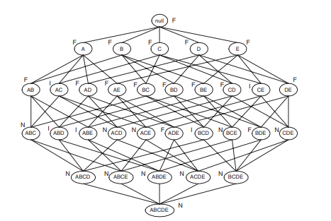
Answer 3
b) Percentage of frequent itemsets = 16/32 = 50.0% (including the null set).
c) Pruning ratio is the ratio of N to the total number of itemsets. Since the count of N = 11, therefore pruning ratio is 11/32 = 34.4%.

Slide 92
Answer 4
Ans a)The leaf nodes visited are L1, L3, L5, L9, and L11.
b) The candidates contained in the transaction are {1, 4, 5}, {1, 5, 8}, and {4, 5, 8}.

Slide 93
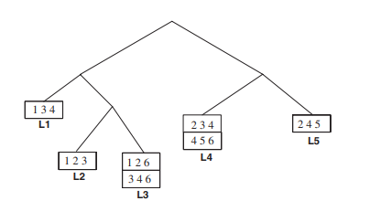
Answer 5

Slide 94
THANK YOU
Dr. N MEHALA
Department of Computer Science and Engineering
mehala@pes.edu

